Slide 1
Real Estate Economics
December 10, 2021

Slide 2


The Team
Parth Varshney
Charlie Bauer
2nd Year ISYE
Economics/Financial Systems
Interested in intersection of financial analysis/operations and data
2nd Year ISYE
Analytics/Data Science
Interested in neural networks and statistical & prescriptive business analytics

Slide 3
Context
Economic indicators like GDP, unemployment, CPI, and interest rates have been used for decades to assess the future growth potential of economies worldwide
This process was especially important in the last few years, where the pandemic forced economists, policymakers, and businesses had to join forces to plan out new ways to run the economy
Economic indicators were heavily stressed as metrics to determine how needed aid, and what type of aid they needed
This allowed for an increase of personal savings and corporate savings during the pandemic and mitigated its economic effects on a variety of individuals

Slide 4
Research Question
Given the importance of economic indicators, we wanted to examine the long term insights derived from economic indicators, correlating these to home values across the time period from 2005-2020
GDP Growth
Unemployment
We intend to explain the roots of the hidden complexity in these indicators, and the importance of viewing each with a different economic lense
Home Values is a not a generally used economic indicator, but given the importance of homeownership in driving wealth in society, we decided to include it in our analysis

Slide 5
Phase I & II:
Source Selection and Preprocessing

Slide 6


CSV Data: Zillow
Zillow home value index (ZHVI) for 30,502 ZIP codes across the United States
Downloaded CSV from their open-source research site

Slide 7
CSV: Zillow
data_parser
data_parser2
Yearly state average of each ZIP’s monthly ZHVI
Not a state-level index
Process involved deleting rows and columns and aggregating the locality values for each state
Macro-level overview
Unaggregated values
Melted/unpivoted date and ZHVI to have all values in a column
Too large for excel

Slide 8
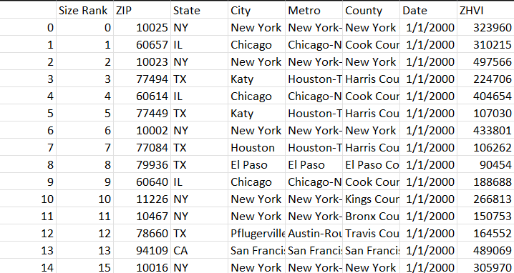
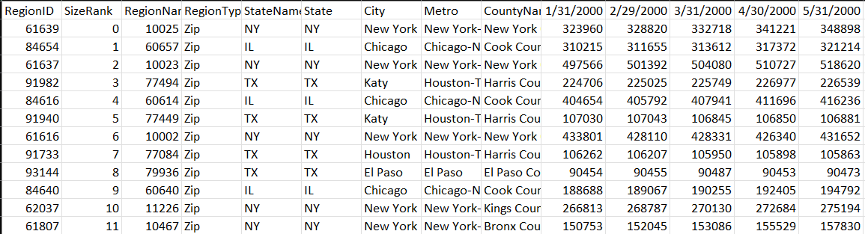
data_parser2()

Slide 9
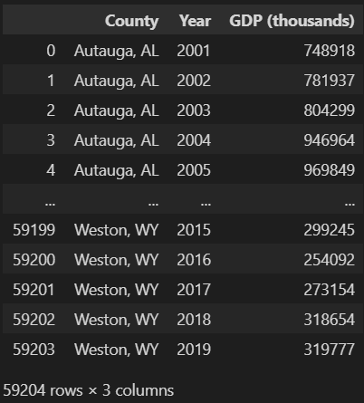

XML API: Bureau of Economic Analysis
API difficult to navigate
We called a few html and xml files that provided lists of datasets, line codes, and tables and their meanings
Selected table: GDP by county
datasets > Regional > line code 1 > table CAGDP2

Slide 10
XML: BEA
web_parser1
Despite difficulty finding the right table, it was surprisingly clean
Parsed XML - had a lot of repeated text and comments but was pretty easy to work with
call_xml = requests.get(call).text
call_soup = bs(call_xml, 'lxml')
gdp_county = pd.DataFrame([(data["geoname"], data["timeperiod"], data["datavalue"]) for data in
call_soup.find_all("data")], columns=['County', 'Year', 'GDP (thousands)'])

Slide 11

JSON API: Bureau of Labor Statistics
API inaccessible to no-parameter HTTP GET (i.e. browser inaccessible)
Difficult to navigate
We called json files and viewed many sites that provided lists of series id and their meanings
Fields: price indices, employment, openings, hours, pay, benefits, injury
Attributes: seasonal adjustment, sector, occupation, location, good/commodity, socioeconomic demographics, time (variable periodicity)
time series > series id + start year + end year + content-type

Slide 12
JSON: BLS
web_parser2
Unwrapped JSON to DataFrame for each Series ID
Set index to months_ago
Joined on months_ago
Changed type and filled nulls
Combined date into one column without letters

Slide 13
Additional XML File: Bureau of Labor Statistics
GDP by industry, 2005-2020
Looked at the first quarter, not average each quarter
Average would change interpretation and compare unlike quarters which is unfair
Certain industries were chosen at various points in analysis

Slide 14
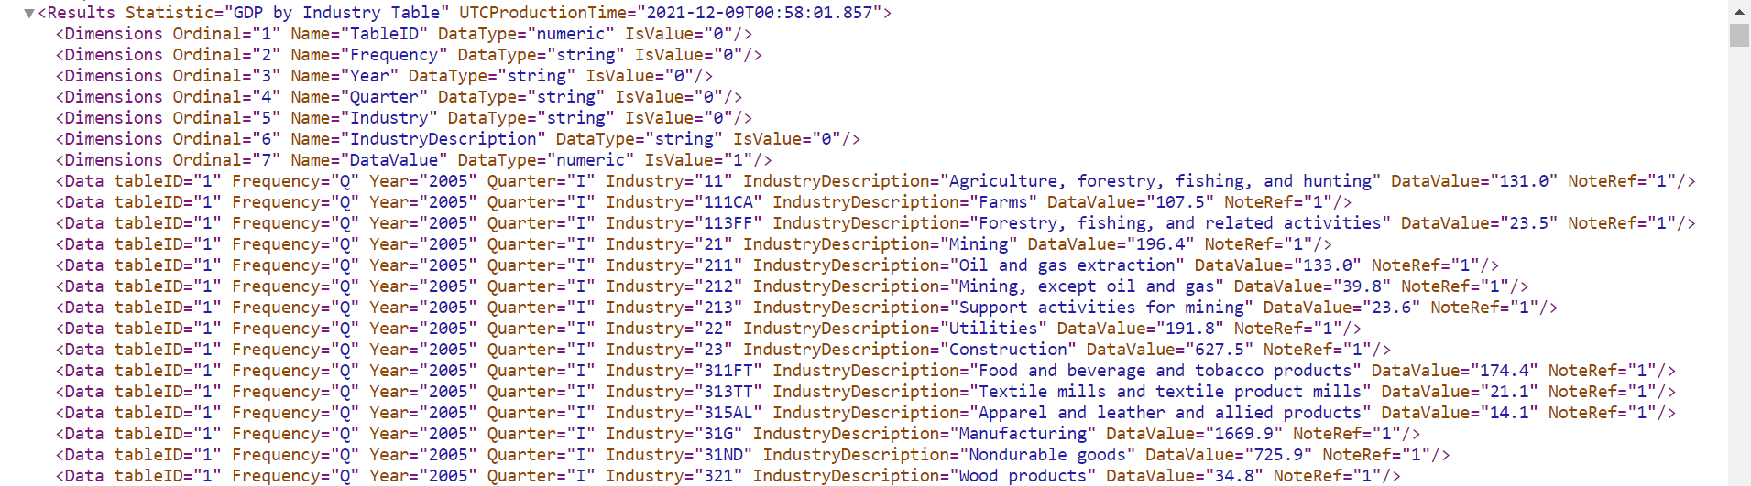
Additional XML: BLS
extra_source1
To expand the scope of our data, we included the GDP values for each region
This provides a more macro-level overview of the driving factors of GDP
This process involved deleting unwanted rows, columns, and selecting only certain time periods to perform our analysis

Slide 15
Phase III:
Data Analysis

Slide 16
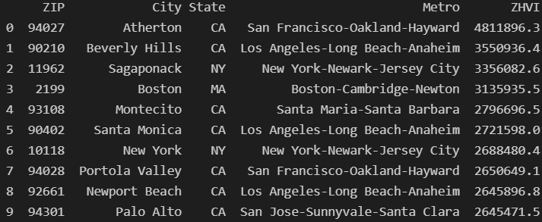
Insight 1: Highest ZIP far above others
Concentrated in CA and NY
CA has the highest average-ZIP home value but NY is not far above US-average
Highest GDP is concentrated in cities but highest home value ZIP are spread out

Slide 17
Although most of the states have consistently stayed within a reasonable range of home values, each contributes differently to the overall average
Most states hover over similar values throughout their lifetimes, as shown in the heatmap
A handful of states contribute to the increase in home values over time, staying relatively constant throughout this period of time (California, DC (region) Hawaii)
These are only a handful of regions and the others hover around very similar values
Implications:
Although there exist large disparities in home values between the three aforementioned regions and the rest of the country, the overall trend is an increase in the price over the average home throughout time
Solely from a price perspective, it would be advantageous for a buyer to avoid three regions, as we see that the home values in every other region are somewhat similar

Slide 18
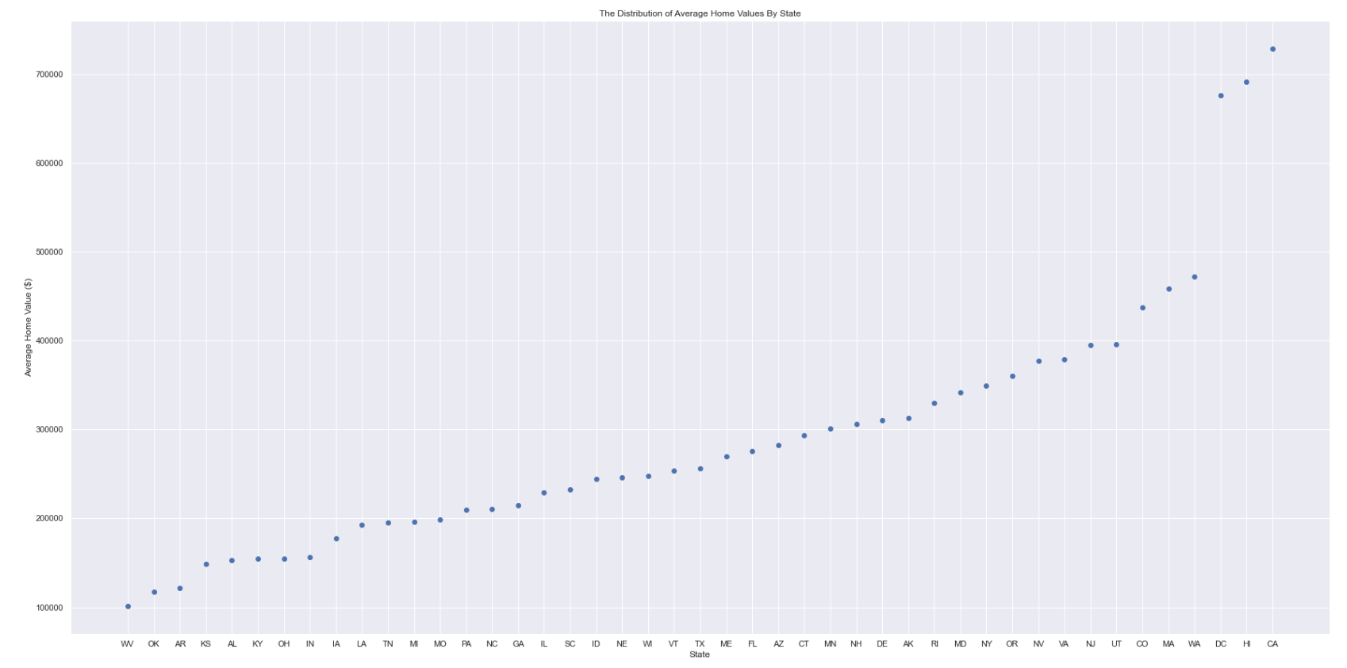
DC, HI, CA are significantly above the rest in average of each ZIP’s

Slide 19
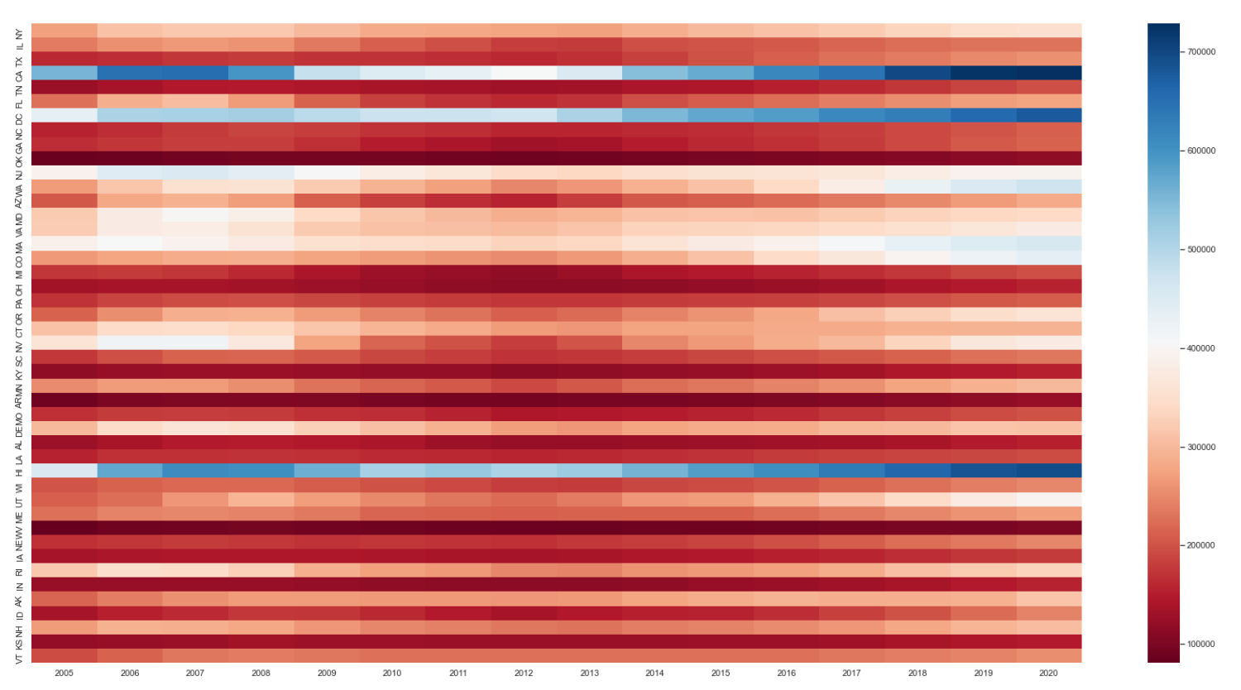
DC, HI, CA are significantly above the rest in average of each ZIP’s and decreased most in 2008

Slide 20
Although most of the states have consistently stayed within a reasonable range of home values, each contributes differently to the overall average
Low Value
Low-Mid Value
Mid Value
Mid-High Value
High Value
West Virginia (WV)
Oklahoma (OK)
Arkansas (AR)
Kansas (KS)
Alabama (AL)
Kentucky (KY)
Ohio (OH)
Indiana (IN)
IA (Iowa)
Louisiana (LA)
Tennessee (TN)
Michigan (MI)
Missouri (MO)
$ 100,000 - $ 200,000
Pennsylvania (PA) North Carolina (NC)
Georgia (GA)
Illinois (IL)
South Carolina (SC)
Indiana (IN)
Nebraska (NE)
Wisconsin (WI)
$ 200,000 - $ 250,000
Vermont (VT)
Texas (TX)
Maine (ME)
Florida (FL)
Arizona (AZ)
Connecticut (CT)
Minnesota (MN)
New Hampshire (NH)
Delaware (DE)
Alaska (AK)
Rhode Island (RI)
Maryland (MD)
New York (NY)
$ 250,000 - $ 350,000
Oregon (OR)
Nevada (NV)
Virginia (VA)
New Jersey (NJ)
Utah (UT)
Colorado (CO)
Massachusetts (MA)
Washington (WA)
$ 350,000 - $ 480,000
Washington, DC
Hawaii
California
$ 675,000 - $ 730,000

Slide 21
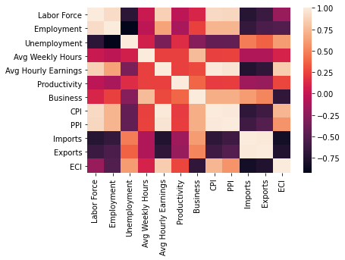
Insight 2: BLS Correlations
Magnitude of negative correlation with months_ago represents the increase over time of that field
Labor force, employment, and unemployment sizes have slightly different correlations
The down echelon (correlation of fields with themselves) is the main light colored area -> not many fields are strongly positively correlated

Slide 22
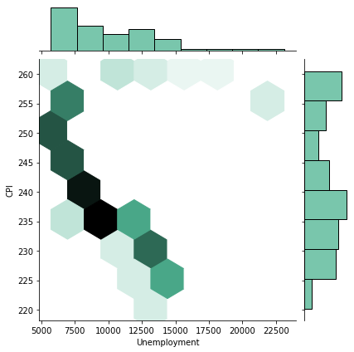
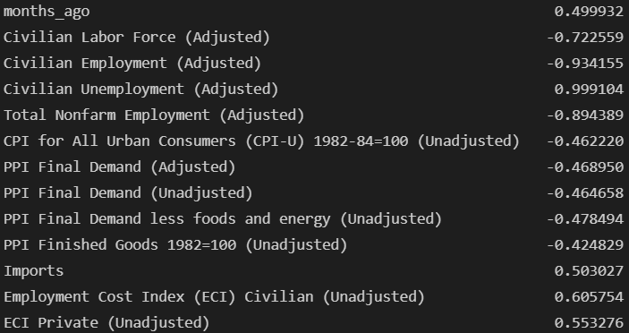
Insight 2: Unemployment has many correlations
unemploy_corr = bls.corr()['Unemployment Rate (Adjusted)']
unemploy_corr[(abs(unemploy_corr) > 0.4) & (abs(unemploy_corr) != 1)]

Slide 23
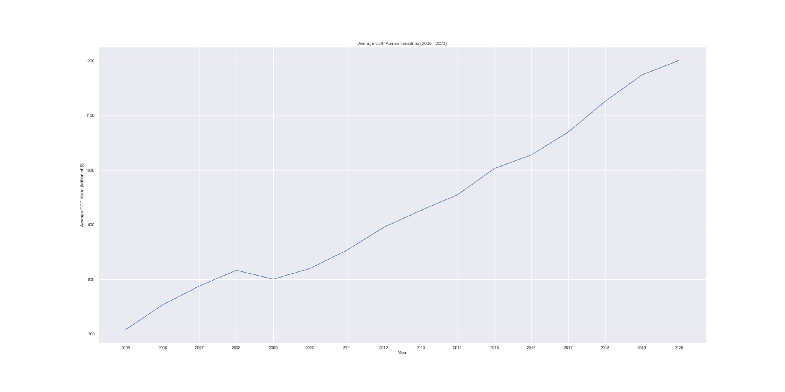
Insight 3: In contrast to average home values, GDP growth is a fairly linear trend

Slide 24
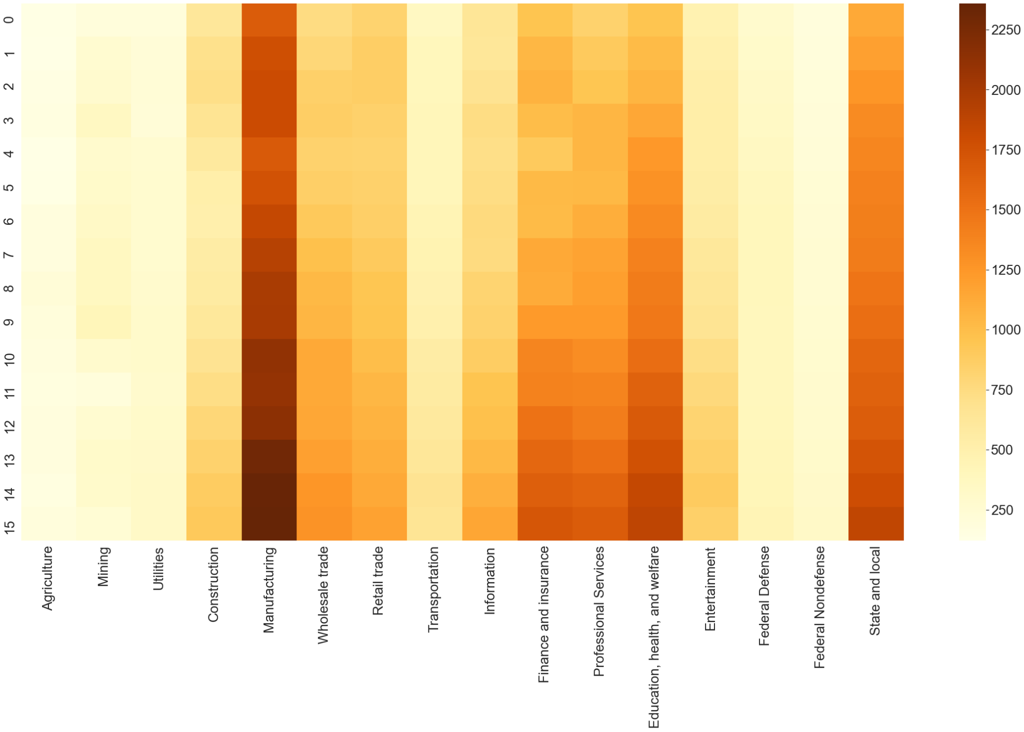
GDP for a specific sector can be less linear (ex. construction, manufacturing, finance & insurance)

Slide 25
Despite the linear nature of GDP growth, it too does tend to aggregate in certain sectors much more than others
Top Sectors by GDP
Real Estate and Rental Leasing: 2827.7
Government: 2697.2
Manufacturing: 2358.8
Finance and Insurance: 1715.1
Professional, Scientific, and Technical Services: 1669. 3
Healthcare and Social Assistance: 1598.9
Implications
Certain industries disproportionately impact others
Certain sectors are prioritized by policymaking

Slide 26
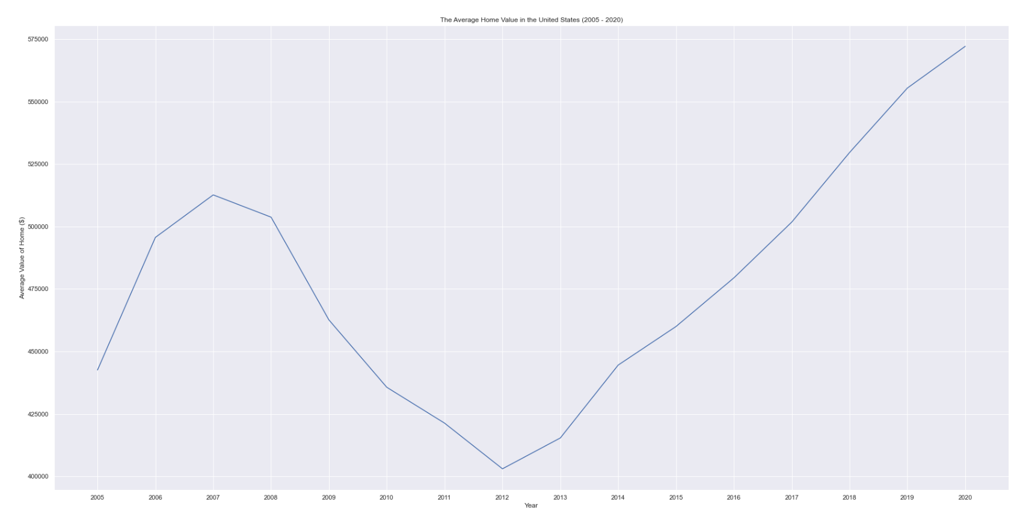
Insight 4: Average ZIP home value is non-linear
But it is over the last 5 years

Slide 27
Insight 4: ZHVI over time Regression
Each state's yearly average of each ZIP's monthly ZHVI vs. year
Low mean R^2 → quite nonlinear
Low variance → each state's R^2 is very close to mean
Each state’s relationship with time follows similar pattern
Statistic: R^2 of a state’s ZHVI vs. year
Mean: 0.3908391210953122
Variance: 9.234412823046364e-05
Insight 3 method
separated columns into int NumPy array
stats.models.api.OLS calculated regression and related values
Insight 4 method
separated columns into int NumPy array
Used math operators on arrays to find regression values
R^2 = 1 - RSS / SST
RSS = residual sum of squares
SST = sum of squares total

Slide 28
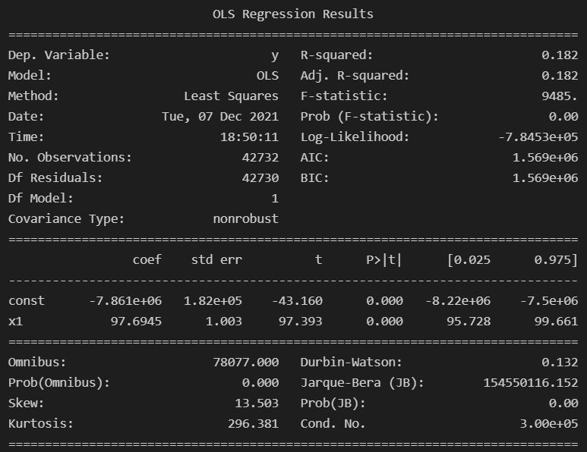
Insight 5: GDP and home value are correlated positively, non-linearly and inconsistently
97.5% confidence interval for slope = [95.728, 99.661]
97.5% confidence interval for slope (ZHVI vs. GDP in thousands) = [0.001817, 0.00190]
$1 GDP correlates to between $1.82 to $1.91 home value, which is a small but present positive correlation
*Slopes are not reciprocals

Slide 29
Thank you for watching and for a great semester!

